Slide 1
Air Route Capacity
Definition: Maximum allowable rate with which aircrafts can be released at the starting point of the route.
This maximum allowable rate depends upon:
Longitudinal Separation Minimum
Speed and the range of speeds of aircraft
Length of the route
Any Route Intersections

Slide 2
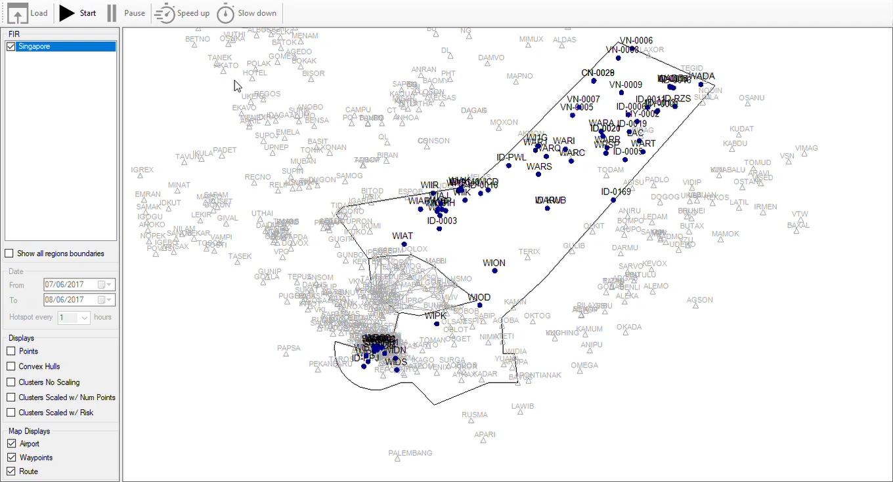
Air Route Capacity
Definition: Maximum allowable rate with which aircrafts can be released at the starting point of the route.

Slide 3
Air Route Capacity Model
Three Models for Parallel Routes ONLY (no crossings):
Based on assumption of common average speed of aircraft
Based on assumption that overtaking of one aircraft by another is not allowed
Based on allowance of certain maximum number of overtaking
Overtaking adds to controller workload
Overtaking also indicates that a sector/airspace is congested

Slide 4
Air Route Capacity Model
Capacity based on Average Aircraft Speed
Simplest Approach Quick Calculation
Assumes common average speed for all aircraft in airspace
Analogues to the capacity of highway lanes where the average speed of automobiles and a safe headway is used to establish the maximum throughput per lane.
Early stages of Airspace Design when detailed information about composition of traffic and navigation infrastructure is not known

Slide 5
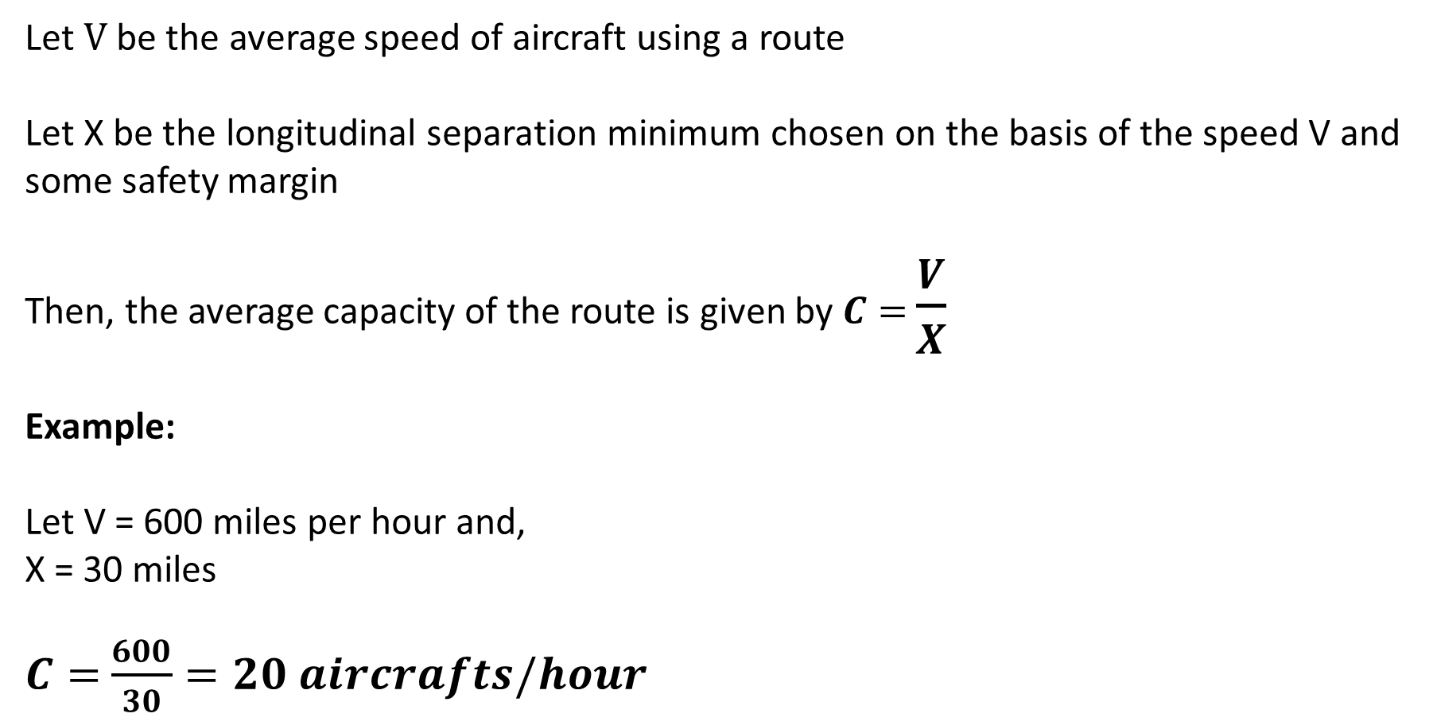
Air Route Capacity Model
based on Average Aircraft Speed
Let $V$ be the average speed of aircraft using a route
Let X be the longitudinal separation minimum chosen on the basis of the speed V and some safety margin
Then, the average capacity of the route is given by $C=$ $\frac{V}{X}$
Example:
Let V = 600 miles per hour and,
X = 30 miles
$C=$ $\frac{600}{30}=20 aircrafts/hour$

Slide 6
Air Route Capacity Model
based on Variable Aircraft Speed and No Passing Allowed
Suppose that the speeds of aircrafts using a common air route vary between V₁ and V₂ miles per hour
With V₁ > V₂
Let the route length be L miles
Let the separation minima be X miles (i.e. two aircrafts, one behind the other, should not come closer than X miles at any time)

Slide 7
Air Route Capacity Model
based on Variable Aircraft Speed and No Passing Allowed
The worst condition in terms of one aircraft following another is when an Aircraft flying at V2 mph is followed by an Aircraft flying at V1.
Faster aircraft will not overtake the slower aircraft before the slower aircraft reached its exit point/destination D.
The faster aircraft must be released from the origin O at time T hours after the slower aircraft
So let’s first find out T

Slide 8
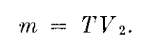
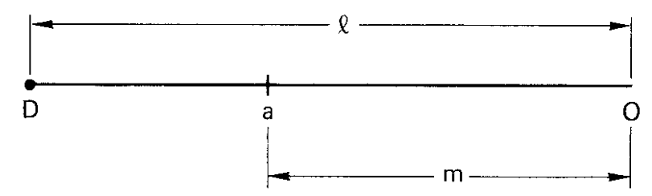
Air Route Capacity Model
based on Variable Aircraft Speed and No Passing Allowed
Let Aircraft a be at a distance m miles away from O after T hours, when Aircraft b is released from O.

Slide 9
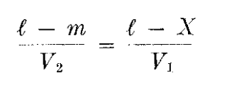
Air Route Capacity Model
based on Variable Aircraft Speed and No Passing Allowed
If Aircraft a reaches D when aircraft b is X miles away from D, there will be no conflict.
Thus we must have:

Slide 10
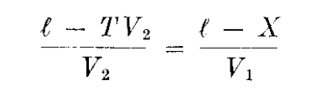
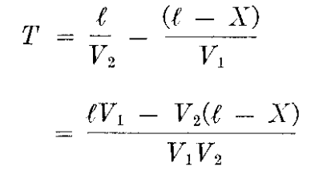
Air Route Capacity Model
based on Variable Aircraft Speed and No Passing Allowed
substituting
in
Therefore

Slide 11
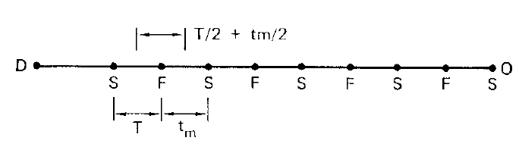
Air Route Capacity Model
based on Variable Aircraft Speed and No Passing Allowed
If more than two aircraft follow each other during a period of, say, 1 hour, the worst sequence in terms of one aircraft overtaking another will be shown as:
F: Fast Aircraft
S: Slow Aircraft
A slow aircraft following a fast aircraft can be released from the origin immediately after the release of the fast aircraft. However, according to ATC rules, there has to be a lapse of a certain minimum time t, before the release of the second (slower) aircraft.
(Going from Right to Left) The time separation between S and F is , and that between F and S is tm and F and S is T

Slide 12
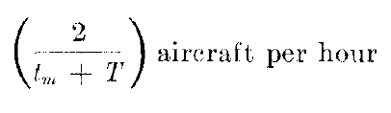
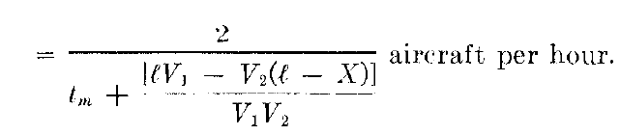
Air Route Capacity Model
based on Variable Aircraft Speed and No Passing Allowed
It can easily be seen that there is one aircraft in each of the time spans
Therefore average number of aircraft that, can be released along route OD per hour is:
Substituting value of T

Slide 13
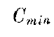
Air Route Capacity Model
based on Variable Aircraft Speed and No Passing Allowed
We denote this number of aircraft by C_{min}.
The theoretical minimum capacity of the air-route assuming the worst sequence of slow and fast aircrafts with no passing allowed.

Slide 14
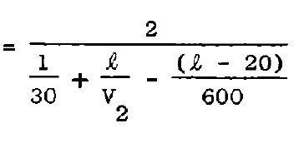
Air Route Capacity Model
based on Variable Aircraft Speed and No Passing Allowed
A worked Example
Let: tm = 2 mins = 1/30 hours
X = 20 miles
V1 = 600 mph
If V2 = 550 and l = 500 miles then

Slide 15
Air Route Capacity Model
Actually, the worst sequence is very unlikely to occur, and passing of aircraft is allowed in air traffic control.
A more realistic measure of capacity should have Passing Allowed.
Let us first consider only two types of aircraft, having speeds V1 and V2 with V1 > V2
Let the corresponding flows be f1 and f2 per hour.
Consider a route length of l miles. If we consider flow f2 independently, the average spacing between aircraft with speed V2 will be V2/f2
The speed of the fast aircraft relative to the slow aircraft will be (V2-V1) mph.

Slide 16
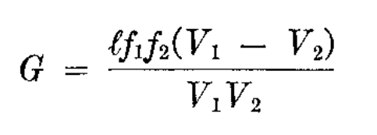
Air Route Capacity Model
During a period of 1 hour, the string of fast-moving aircraft will travel a distance of (V1 – V2) miles relative to the string of slow-moving aircraft.
During this period, each fast-moving aircraft will overtake (V1 – V2) f2/V2 slow-moving aircraft.
In the length l there will be, on the average, l (f1/V1) fast- moving aircraft.
Thus, during a period of 1 hour, the total number of overtaking G will be

Slide 17
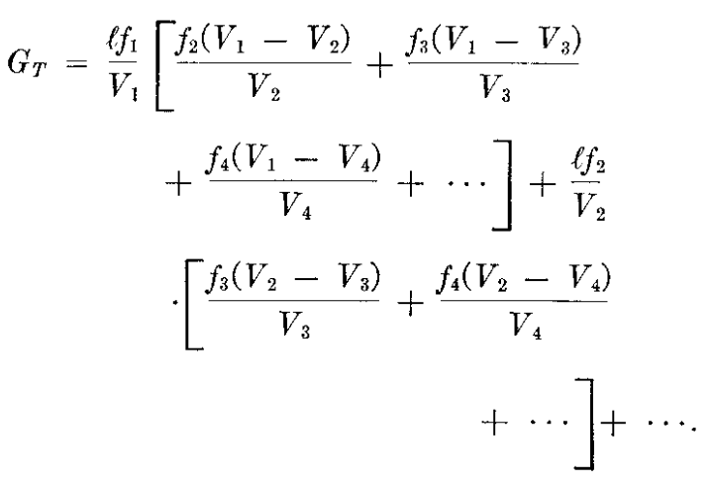
Air Route Capacity Model
If there were other types of aircraft having speeds of V3, V4, …with V1 > V2 > V3 > V4 >.. , the total number of overtaking per hour would be:
For any specified value of GT and l (e.g., two over takings per hour per 100 miles), the capacity of the air route is the set of all the combinations of the values of f1,f2,f3,…that satisfied this equation

Slide 18
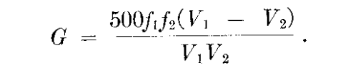
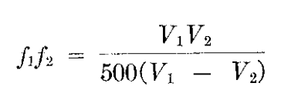
Air Route Capacity Model
Two aircraft example with V1 and V2 and l =500 miles
If G = 1 overtaking per hour then following equation gives the capacity of air route per 500 miles in terms of product of two types of aircraft.
V1 (mph) | V2 (mph) | f1f2
600 | 550 | 13
 | 500 | 6
 | 450 | 3

Slide 19
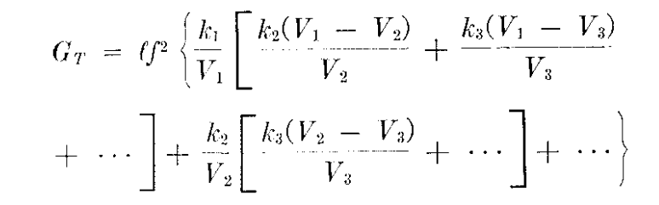
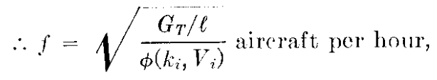
Air Route Capacity Model
If f1, f2, f3 are known as fraction of total flow f
i.e. fi = kif then GT equation can be rearranged as:

Slide 20
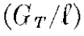
Air Route Capacity Model
Gives the capacity of a single air route in terms of allowable average numbers of over takings per hour per unit length of air route
Example: Let us consider a mix of three types aircrafts:
Let V1= 600, V2 = 500, V3 = 400
Let k1 = 0.6, k2 = 0.2, k3 = 0.2
Let =1/250 i.e. one overtaking per 250 miles per hour
Substituting these values gives f = 5 aircraft per hour

